Slide 1
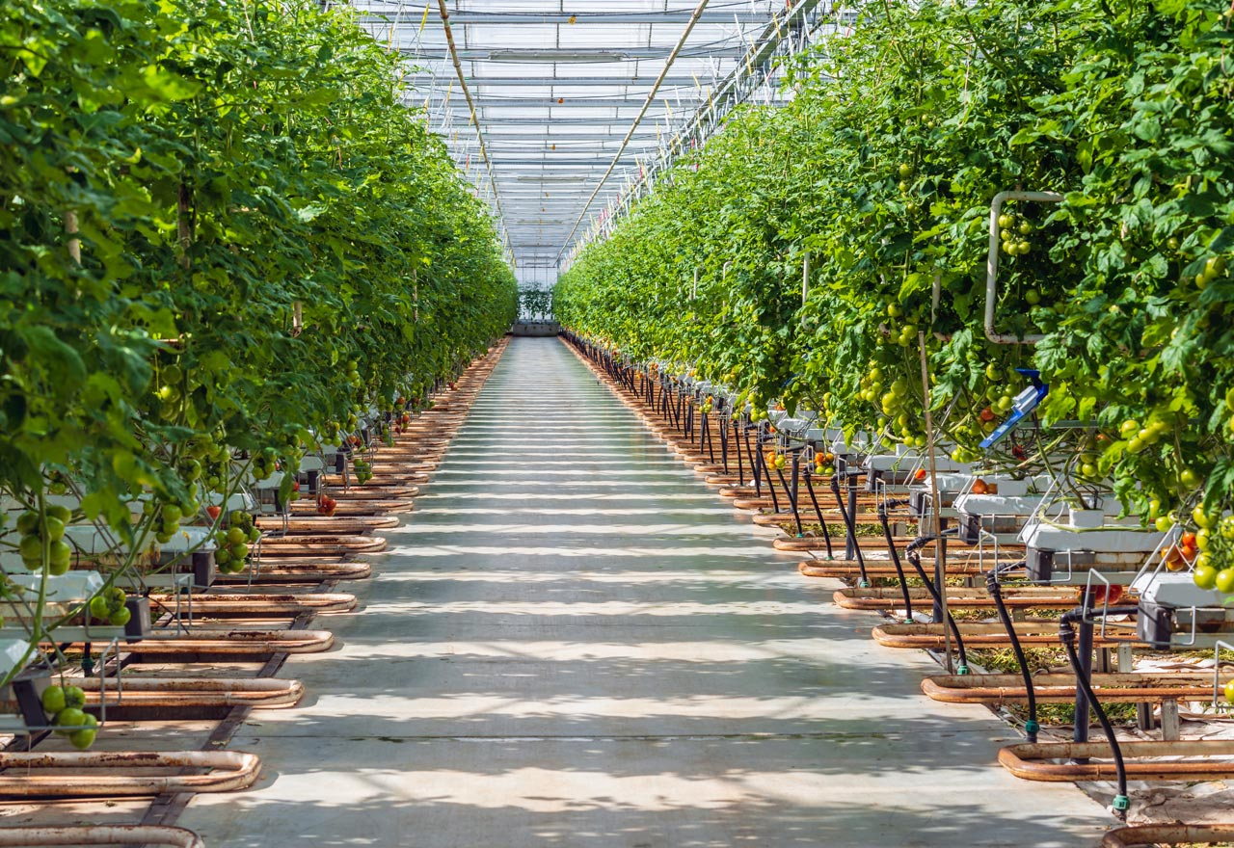

Project name: Deep Learning for Hydroponic Soybean Growth Team members: Samuel He, Mary Hughes

Slide 2
Project Description
Problem Statement:
Researchers take time to track the solution and day of growth of a hydroponically grown plant
i.e. Data can be lost, corrupted, or incorrectly tracked
Solution
Deep learning model and user interface that:
Tracks the solution of hydroponically grown plants
Tracks day of growth of hydroponically grown plants

Slide 3
Diagram of subsystems and interface
Input (user interface)
Deep Learning Model
Output (user interface)
Image Annotation
Samuel He
Mary Hughes
Shared

Slide 4
Major Updates
Per our sponsor, we will not be training the deep learning model this semester.
They will provide us with a temporary trained deep learning model for the User Interface to communicate with.

Slide 5
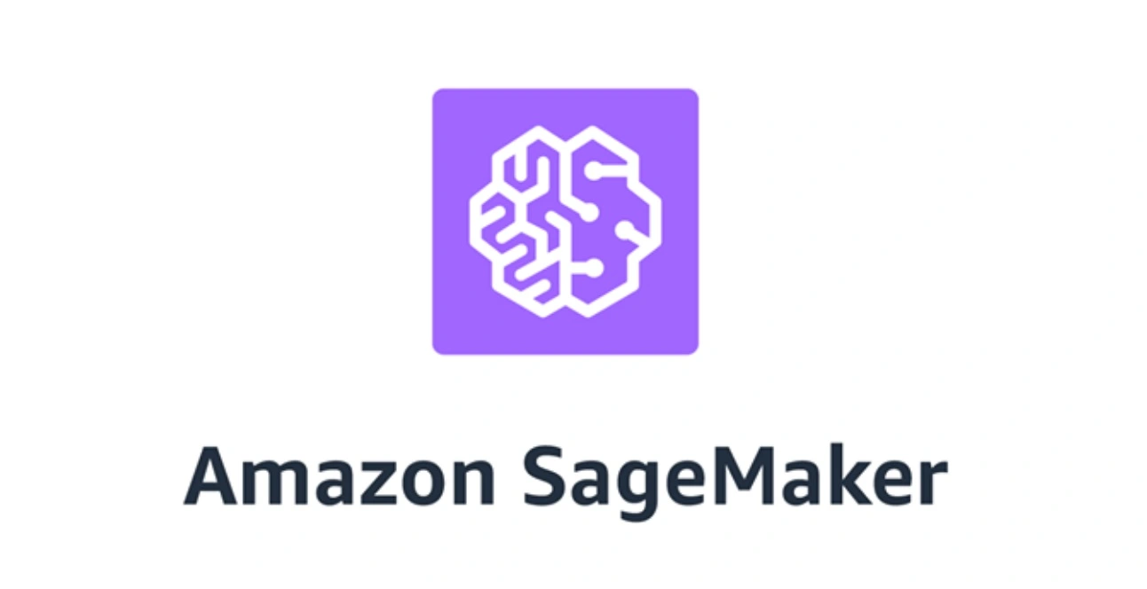
Deep Learning Model
Mary Hughes
Convolutional Neural Network:
TensorFlow’s Python libraries
Machine Learning Training Environment:
AWS SageMaker
Again, we will be using a temporary model this semester
Currently looking into other existing models that use different data sets for training so we have a clear path for next semester.

Slide 6
User Interface Updates
Mary Hughes
Since last presentation:
Finalized front end design for the web app
Created the environment in Elastic Beanstalk

Slide 7
User Interface Updates
Samuel He
Finished:
Tech Stack:
Front End: ReactJS
Back End: Flask (Python)
Hosting website on Elastic Beanstalk
In Progress:
Linking Backend API calls to AWS SageMaker
UI Design

Slide 8
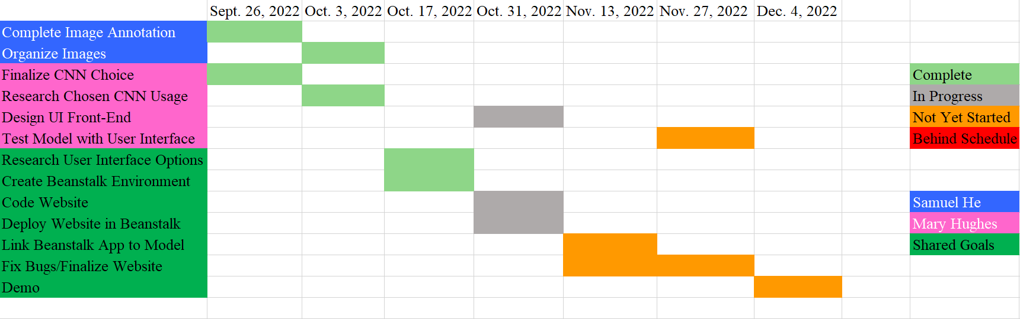
Execution plan

Slide 9
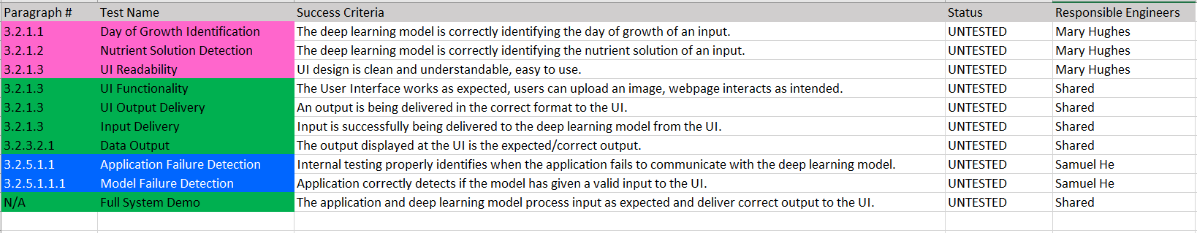
Validation plan

